Slide 1
Memory Management

Slide 2
Memory Management
Background
Swapping
Contiguous Memory Allocation
Segmentation
Paging
Structure of the Page Table
Example: The Intel 32 and 64-bit Architectures
Example: ARM Architecture

Slide 3
Objectives
To provide a detailed description of various ways of organizing memory hardware
To discuss various memory-management techniques, including paging and segmentation
To provide a detailed description of the Intel Pentium, which supports both pure segmentation and segmentation with paging

Slide 4
Background
Program must be brought (from disk) into memory and placed within a process for it to be run
Main memory and registers are only storage CPU can access directly
Memory unit only sees a stream of addresses + read requests, or address + data and write requests
Register access in one CPU clock (or less)
Main memory can take many cycles, causing a stall
Cache sits between main memory and CPU register.

Slide 5
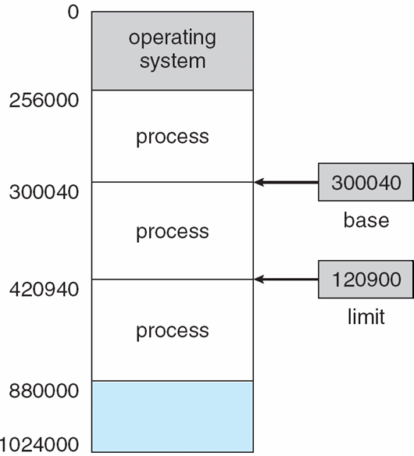
Base and Limit Registers
To access the memory , memory addresses are required.
A pair of base and limit registers define the logical address space
CPU must check every memory access generated in user mode to be sure it is between base and limit for that user

Slide 6
Hardware Address Protection

Slide 7
NOTE:
The base and limit registers can be loaded only by the operating system.
The OS in kernel mode is given unrestricted access to both operating system memory and user’s memory.
The OS loads the user program to users memory, to dump out those programs in case of errors, to access and modify parameters of system calls etc.

Slide 8
Address Binding
Execution:
Input Queue -> Memory -> Execution -> Free Memory
.Programs on disk, ready to be brought into memory to execute form an input queue
Inconvenient to have first user process physical address always at 0000
Further, addresses represented in different ways at different stages of a program’s life
Source code addresses usually symbolic.( int x)
Compiled code addresses bind to relocatable addresses
i.e. “14 bytes from beginning of this module”
Linker or loader will bind relocatable addresses to absolute addresses
i.e. 74014
Each binding maps one address space to another

Slide 9
Binding of Instructions and Data to Memory
Address binding of instructions and data to memory addresses can happen at three different stages
Compile time: If memory location known a priori, absolute code can be generated; must recompile code if starting location changes
Load time: Must generate relocatable code if memory location is not known at compile time
Execution time: Binding delayed until run time if the process can be moved during its execution from one memory segment to another
Need hardware support for address maps (e.g., base and limit registers)

Slide 10
Memory-Management Unit (MMU)
Hardware device that at run time maps virtual to physical address
Many methods possible, covered in the rest of this chapter
To start, consider simple scheme where the value in the relocation register is added to every address generated by a user process at the time it is sent to memory
Base register now called relocation register
MS-DOS on Intel 80x86 used 4 relocation registers
The user program deals with logical addresses; it never sees the real physical addresses

Slide 11
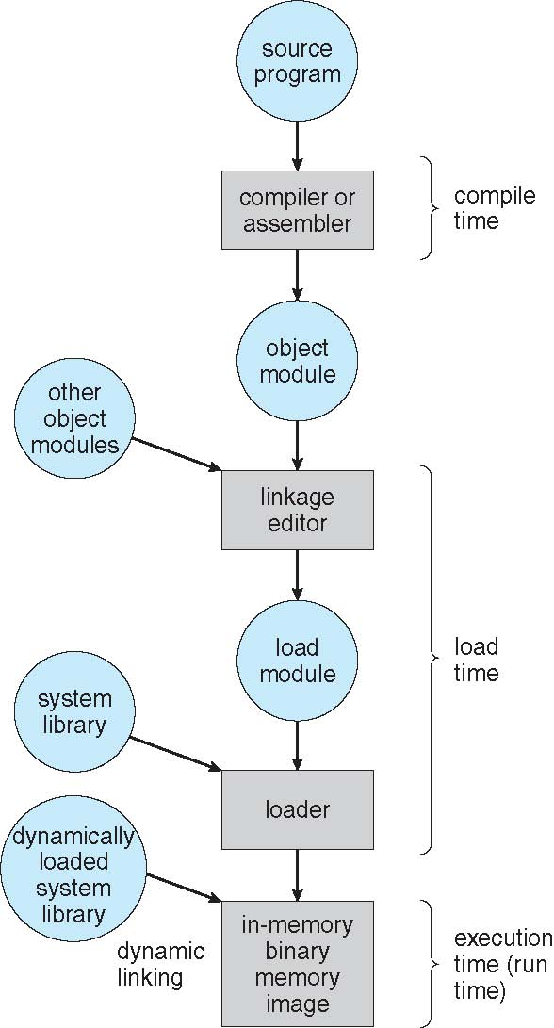
Multistep Processing of a User Program

Slide 12
Logical vs. Physical Address Space
The concept of a logical address space that is bound to a separate physical address space is central to proper memory management
Logical address – generated by the CPU; also referred to as virtual address
Physical address – address seen by the memory unit
Logical address space is the set of all logical addresses generated by a program
Physical address space is the set of all physical addresses generated by a program

Slide 13
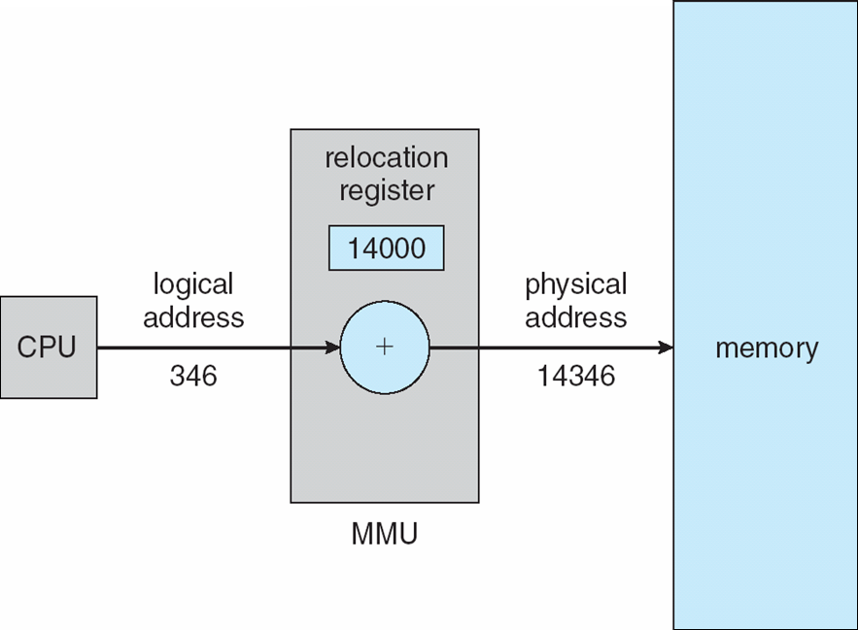
Dynamic relocation using a relocation register
Routine is not loaded until it is called
Better memory-space utilization; unused routine is never loaded
All routines kept on disk in relocatable load format
Useful when large amounts of code are needed to handle infrequently occurring cases
No special support from the operating system is required
Implemented through program design
OS can help by providing libraries to implement dynamic loading

Slide 14
Dynamic Linking
Static linking – system libraries and program code combined by the loader into the binary program image
Dynamic linking –linking postponed until execution time
Small piece of code, stub, used to locate the appropriate memory-resident library routine
The stub indicates how to locate the appropriate memory-resident library routine.
The stub checks to see whether the needed routine is already in memory .
If it is not , the program loads the routine into memory.
The stub replaces itself with the address of the routine and executes the routine.

Slide 15
Swapping
A process can be swapped temporarily out of memory to a backing store, and then brought back into memory for continued execution
Total physical memory space of processes can exceed physical memory
Backing store – fast disk large enough to accommodate copies of all memory images for all users.
Roll out, roll in – swapping variant used for priority-based scheduling algorithms; lower-priority process is swapped out so higher-priority process can be loaded and executed
Major part of swap time is transfer time; total transfer time is directly proportional to the amount of memory swapped
System maintains a ready queue of ready-to-run processes which have memory images on disk

Slide 16
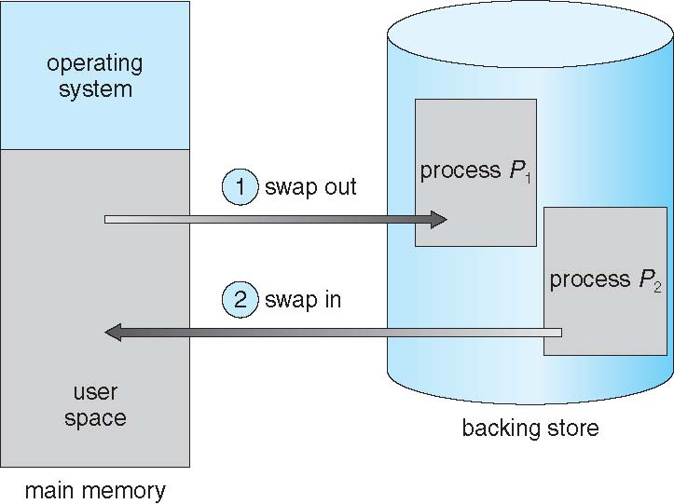
Schematic View of Swapping

Slide 17
Contiguous Allocation
Main memory must support both OS and user processes
Limited resource, must allocate efficiently
Contiguous allocation is one early method
Main memory usually into two partitions:
Resident operating system, usually held in low memory with interrupt vector
User processes then held in high memory
Each process contained in single contiguous section of memory

Slide 18
Contiguous Allocation (Cont.)
Relocation registers used to protect user processes from each other, and from changing operating-system code and data
Base register contains value of smallest physical address
Limit register contains range of logical addresses – each logical address must be less than the limit register
MMU maps logical address dynamically

Slide 19
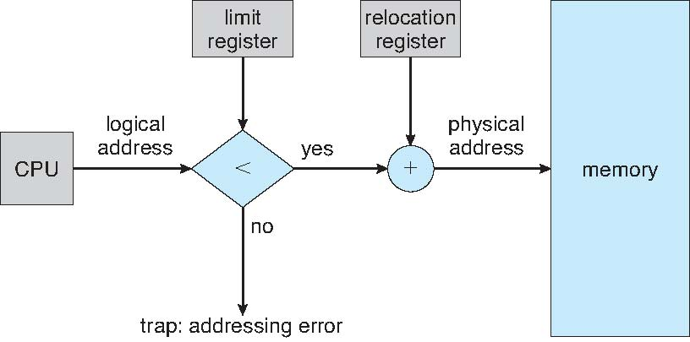
Hardware Support for Relocation and Limit Registers

Slide 20
Multiple-partition allocation
Multiple-partition allocation
one simplest method is to dicide the memory into several fixed sized partition
when a patrition is free, a process is selected from input queue and is loaded into the free partition.
when a process terminates the partition becomes available to other process.
Degree of multiprogramming limited by number of partitions
this method is called MFT (NO longer used .

Slide 21
Generalization of Fixed_partition Scheme
In variable partition scheme the OS keeps a table indicatiing which part of memory are available and which are occupied.
From the input queue the OS computes the size of each process.
Hole – block of available memory; holes of various size are scattered throughout memory
When a process arrives, it is allocated memory from a hole large enough to accommodate it
Process exiting frees its partition, adjacent free partitions combined
Operating system maintains information about: a) allocated partitions b) free partitions (hole)

Slide 22
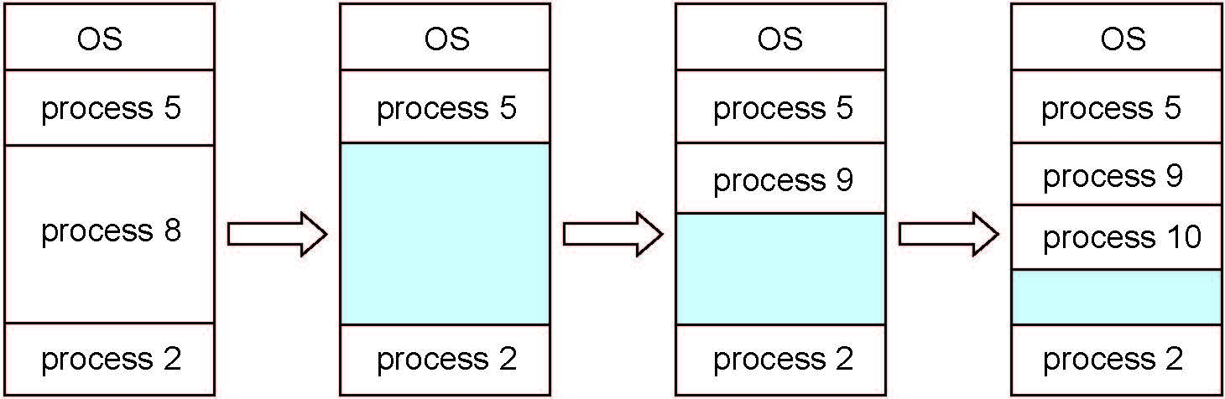

Slide 23
Dynamic Storage-Allocation Problem
How to satisfy a request of size n from a list of free holes?
First-fit: Allocate the first hole that is big enough
Best-fit: Allocate the smallest hole that is big enough; must search entire list, unless ordered by size
Produces the smallest leftover hole
Worst-fit: Allocate the largest hole; must also search entire list
Produces the largest leftover hole
First-fit and best-fit better than worst-fit in terms of speed and storage utilization

Slide 24
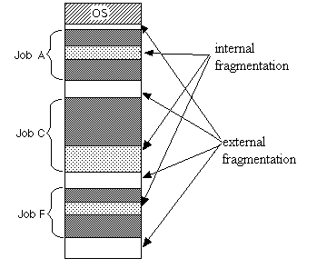
Fragmentation
External Fragmentation – total memory space exists to satisfy a request, but it is not contiguous
Internal Fragmentation – allocated memory may be slightly larger than requested memory; this size difference is memory internal to a partition, but not being used

Slide 25
Fragmentation (Cont.)
Reduce external fragmentation by compaction
Shuffle memory contents to place all free memory together in one large block
Compaction is possible only if relocation is dynamic, and is done at execution time
I/O problem
Latch job in memory while it is involved in I/O
Do I/O only into OS buffers
Now consider that backing store has same fragmentation problems

Slide 26
Segmentation
It is a memory management scheme that supports the programmer view of memory.
A logical address space is collection of segments.
Each segment has a name and a length.
The addresses specify both the segment name and the offset within the segment.
for implimentation purpose the segments are numbered.
and the logical address consist of
< Segment-number, offset>

Slide 27
Segmentation
Memory-management scheme that supports user view of memory
A program is a collection of segments
A segment is a logical unit such as
The code
Global variables
The heap
The stack
The standard C- library etc.

Slide 28
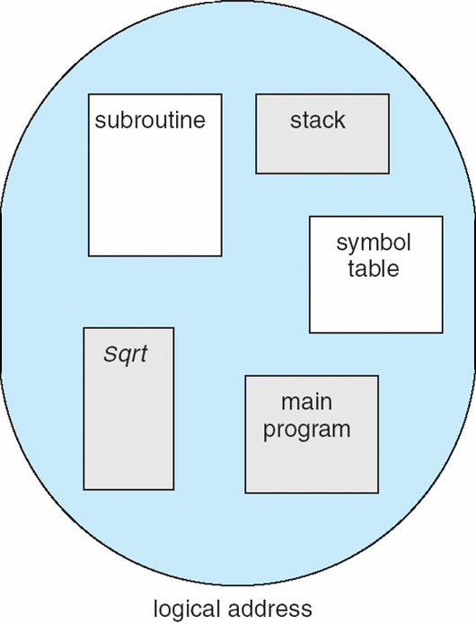
User’s View of a Program

Slide 29
Logical View of Segmentation
1
1
4
2
3
4
2
3
user space
physical memory space

Slide 30
Segmentation Architecture
Logical address consists of a two tuple:
<segment-number, offset>,
Segment table – maps two-dimensional physical addresses; each table entry has:
base – contains the starting physical address where the segments reside in memory
limit – specifies the length of the segment
Segment-table base register (STBR) points to the segment table’s location in memory
Segment-table length register (STLR) indicates number of segments used by a program;
segment number s is legal if s < STLR

Slide 31
Paging
Physical address space of a process can be noncontiguous; process is allocated physical memory whenever the latter is available
Avoids external fragmentation
Avoids problem of varying sized memory chunks
Divide physical memory into fixed-sized blocks called frames
Size is power of 2, between 512 bytes and 16 Mbytes
Divide logical memory into blocks of same size called pages
Keep track of all free frames
To run a program of size N pages, need to find N free frames and load program
Set up a page table to translate logical to physical addresses
Backing store likewise split into pages
Still have Internal fragmentation

Slide 32
Address Translation Scheme
Address generated by CPU is divided into:
Page number (p) – used as an index into a page table which contains base address of each page in physical memory
Page offset (d) – combined with base address to define the physical memory address that is sent to the memory unit

Slide 33
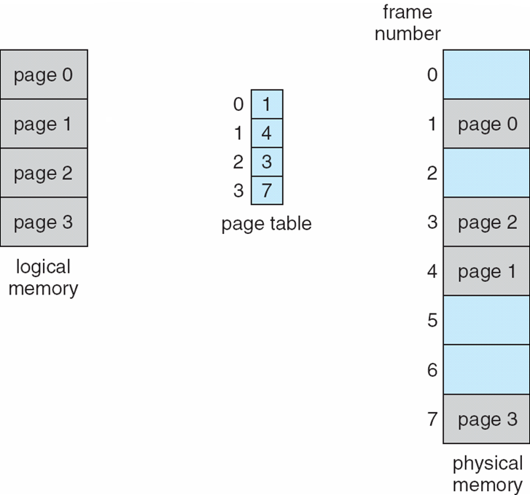
Paging Model of Logical and Physical Memory

Slide 34
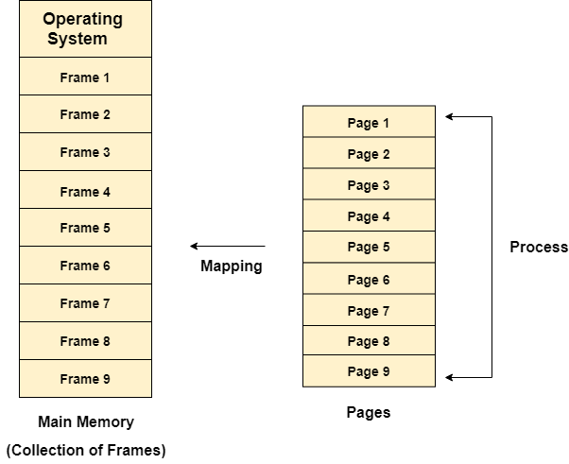

Slide 35
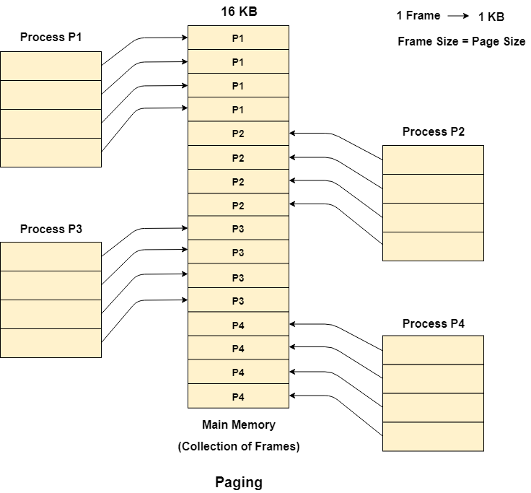

Slide 36
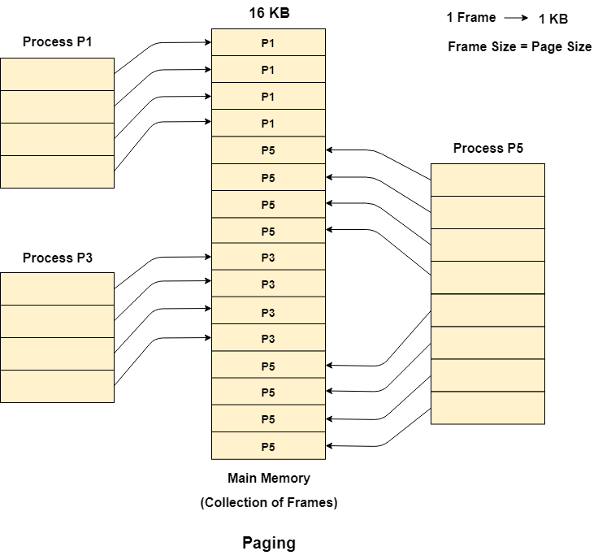

Slide 37
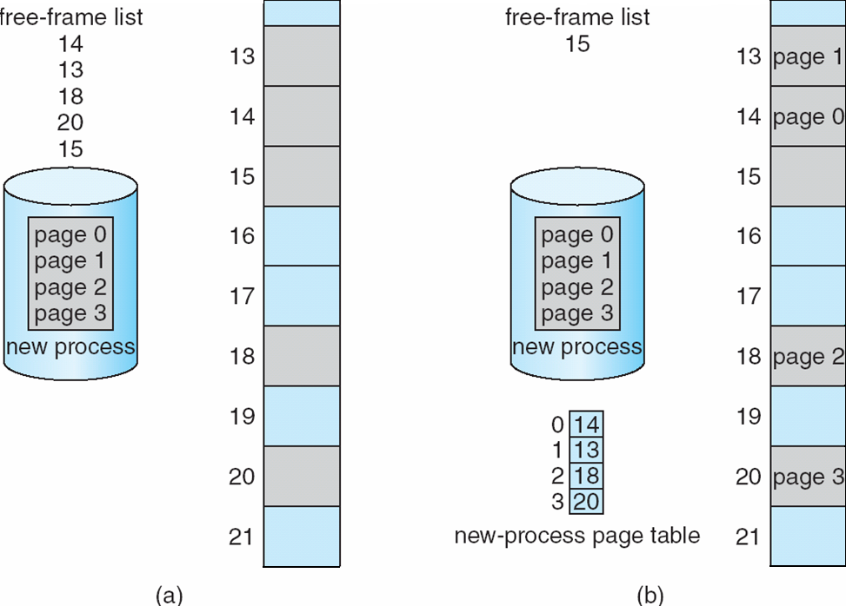
Free Frames
Before allocation
After allocation

Slide 38
Implementation of Page Table
Page table is kept in main memory
Page-table base register (PTBR) points to the page table
Page-table length register (PTLR) indicates size of the page table
In this scheme every data/instruction access requires two memory accesses
One for the page table and one for the data / instruction
The two memory access problem can be solved by the use of a special fast-lookup hardware cache called associative memory or translation look-aside buffers (TLBs)

Slide 39
Associative Memory
Associative memory – parallel search
Address translation (p, d)
If p is in associative register, get frame # out
Otherwise get frame # from page table in memory

Slide 40
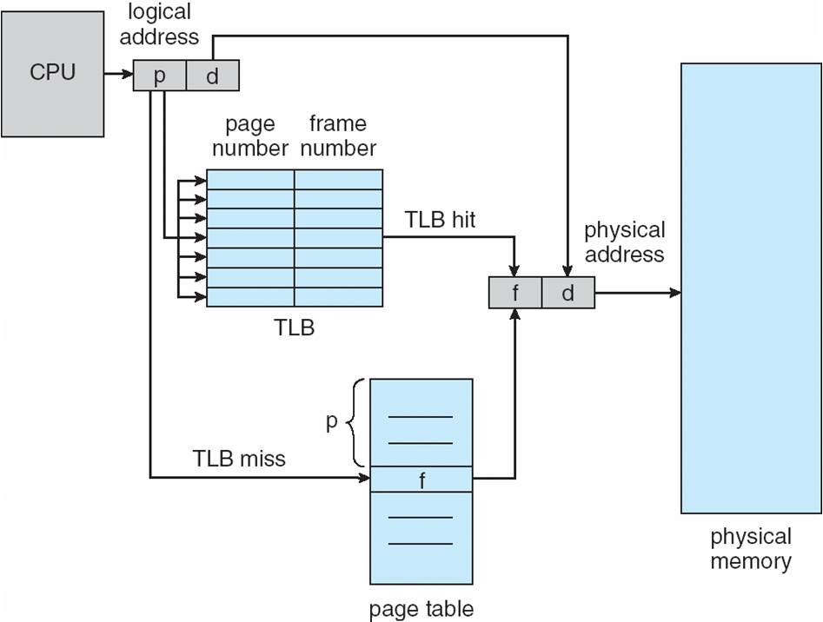
Paging Hardware With TLB

Slide 41
Memory Protection
Memory protection implemented by associating protection bit with each frame to indicate if read-only or read-write access is allowed
Can also add more bits to indicate page execute-only, and so on
Valid-invalid bit attached to each entry in the page table:
“valid” indicates that the associated page is in the process’ logical address space, and is thus a legal page
“invalid” indicates that the page is not in the process’ logical address space
Or use page-table length register (PTLR)
Any violations result in a trap to the kernel

Slide 42
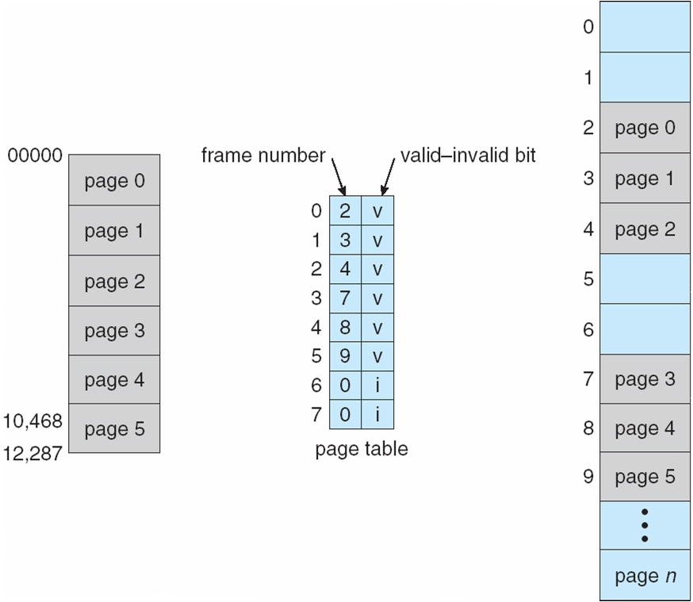
Valid (v) or Invalid (i) Bit In A Page Table

Slide 43
Hierarchical Page Tables
Break up the logical address space into multiple page tables
A simple technique is a two-level page table
We then page the page table

Slide 44
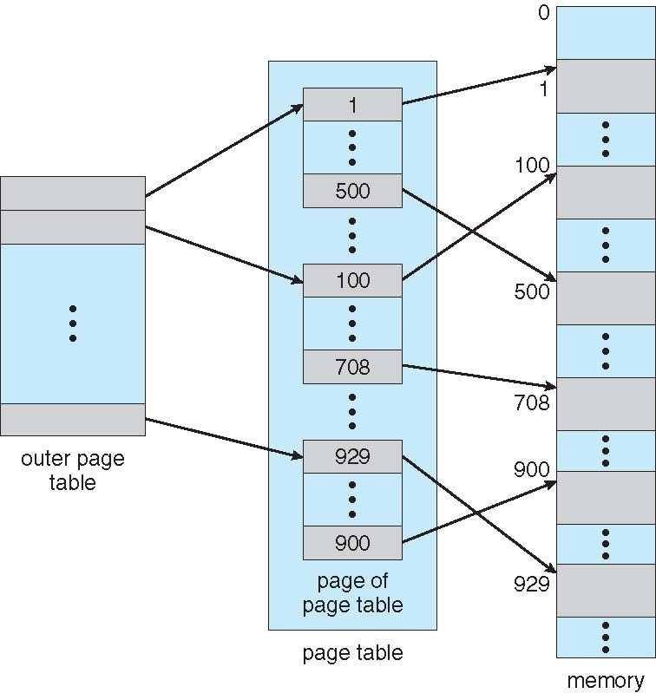
Two-Level Page-Table Scheme

Slide 45
Virtual Memory
Virtual memory is a memory management technique used by os
it allows the computer to compensate for physical RAM limitatios by temporarily transfering the data from RAM to disk storage.
this gives the impression to applications that they have more memory that is physically available.
this enhances system multitasking and overall performance.

Slide 46
In this scheme, whenever some pages needs to be loaded in the main memory for the execution and the memory is not available for those many pages,
then in that case, instead of stopping the pages from entering in the main memory, the OS search for the RAM area that are least used in the recent times or that are not referenced
and copy that into the secondary memory to make the space for the new pages in the main memory.
Since all this procedure happens automatically, therefore it makes the computer feel like it is having the unlimited RAM.

Slide 47
Demand Paging
Demand Paging is a popular method of virtual memory management. In demand paging, the pages of a process which are least used, get stored in the secondary memory.
A page is copied to the main memory when its demand is made or page fault occurs.
There are various page replacement algorithms which are used to determine the pages which will be replaced.

Slide 48
Page Fault
Page Fault:
A page fault occurs when a program attempts to access data or code that is in its address space, but is not currently located in the system RAM.
Pre Paging:
IT is to bring all the pages into the memory that will be needed at the same time before the process references them.
Thrashing:
Thrashing is when the page fault and swapping happens very frequently at a higher rate,
then the operating system has to spend more time swapping these pages.
This state in the operating system is known as thrashing. Because of thrashing,
the CPU utilization is going to be reduced or negligible.

Slide 49
Page Replacement Algorithms
Page-replacement algorithm
Want lowest page-fault rate on both first access and re-access
Evaluate algorithm by running it on a particular string of memory references (reference string) and computing the number of page faults on that string
String is just page numbers, not full addresses
Repeated access to the same page does not cause a page fault
Results depend on number of frames available
In all our examples, the reference string of referenced page numbers is
7,0,1,2,0,3,0,4,2,3,0,3,0,3,2,1,2,0,1,7,0,1

Slide 50
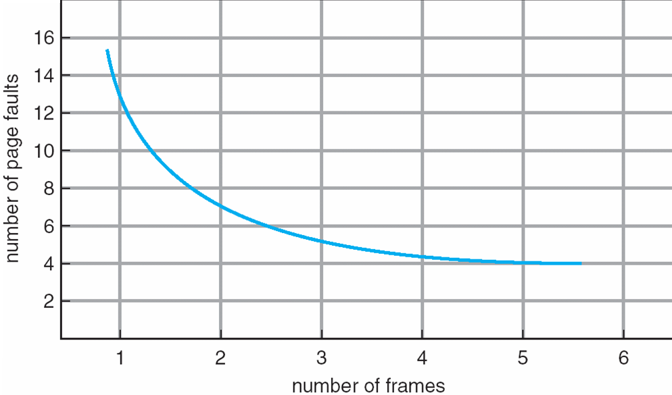
Graph of Page Faults Versus The Number of Frames

Slide 51
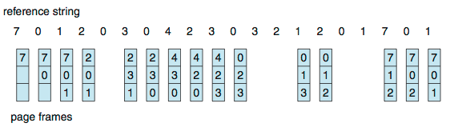
First-In-First-Out (FIFO) Algorithm
Reference string: 7,0,1,2,0,3,0,4,2,3,0,3,0,3,2,1,2,0,1,7,0,1
3 frames (3 pages can be in memory at a time per process)
Can vary by reference string: consider 1,2,3,4,1,2,5,1,2,3,4,5
Adding more frames can cause more page faults!
Belady’s Anomaly
Reference String ( 0, 1, 5, 3, 0, 1, 4, 0, 1, 5, 3, 4)
No of Page Faults with 3 frames= (9), No. of Page Faults with 4 frames=(10)
15 page faults

Slide 52
FIFO Illustrating Belady’s Anomaly

Slide 53
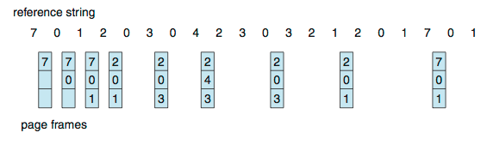
Optimal Algorithm
Replace page that will not be used for longest period of time
9 is optimal for the example
How do you know this?
Can’t read the future
Used for measuring how well your algorithm performs

Slide 54
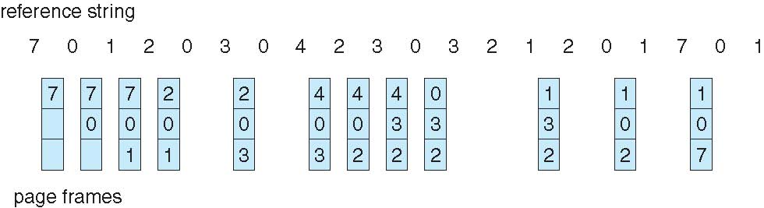
Least Recently Used (LRU) Algorithm
Use past knowledge rather than future
Replace page that has not been used in the most amount of time
Associate time of last use with each page
12 faults – better than FIFO but worse than OPT
Generally good algorithm and frequently used

Slide 55
THANK YOU

